Slide 1

SCALABLE DATABASE
MIDTERM PROJECT
BRAINSTORM BUDDIES
sql queries
data analysis
data source
objectives
git
data cleaning
Rohan Niranjan Kalpavruksha Roshan Niranjan Kalpavruksha Srimanth Madira Vaishnavi Koya

Slide 2



Arrest Data (Public Safety)
SCALABLE DATABASE
MIDTERM PROJECT
Datasets of Larger size
(approx. 10000 – 15000 rows)
BRAINSTORM BUDDIES
sql queries
data source
data analysis
objectives
git
data cleaning
Rohan Niranjan Kalpavruksha Roshan Niranjan Kalpavruksha Srimanth Madira Vaishnavi Koya
Air Quality (Environment)
Water Consumption (Housing and Development)

Slide 3

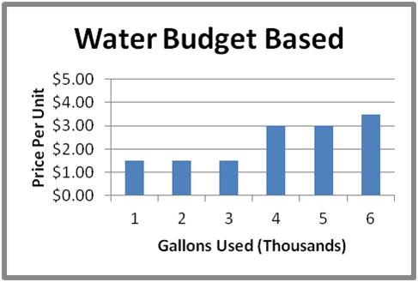

SCALABLE DATABASE
MIDTERM PROJECT
Analyzing Air Quality Trends on demographics
BRAINSTORM BUDDIES
Evaluating the utilization of water and its associated expenses
sql queries
data analysis
data source
git
objectives
data cleaning
Rohan Niranjan Kalpavruksha Roshan Niranjan Kalpavruksha Srimanth Madira Vaishnavi Koya
Understanding Trends in Law Enforcement

Slide 4
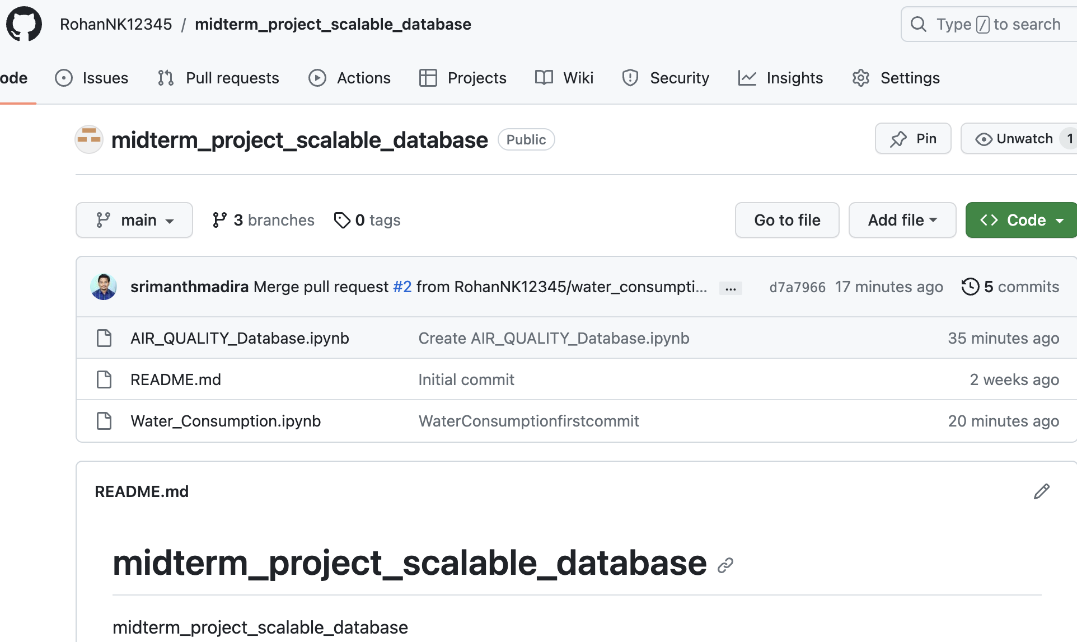



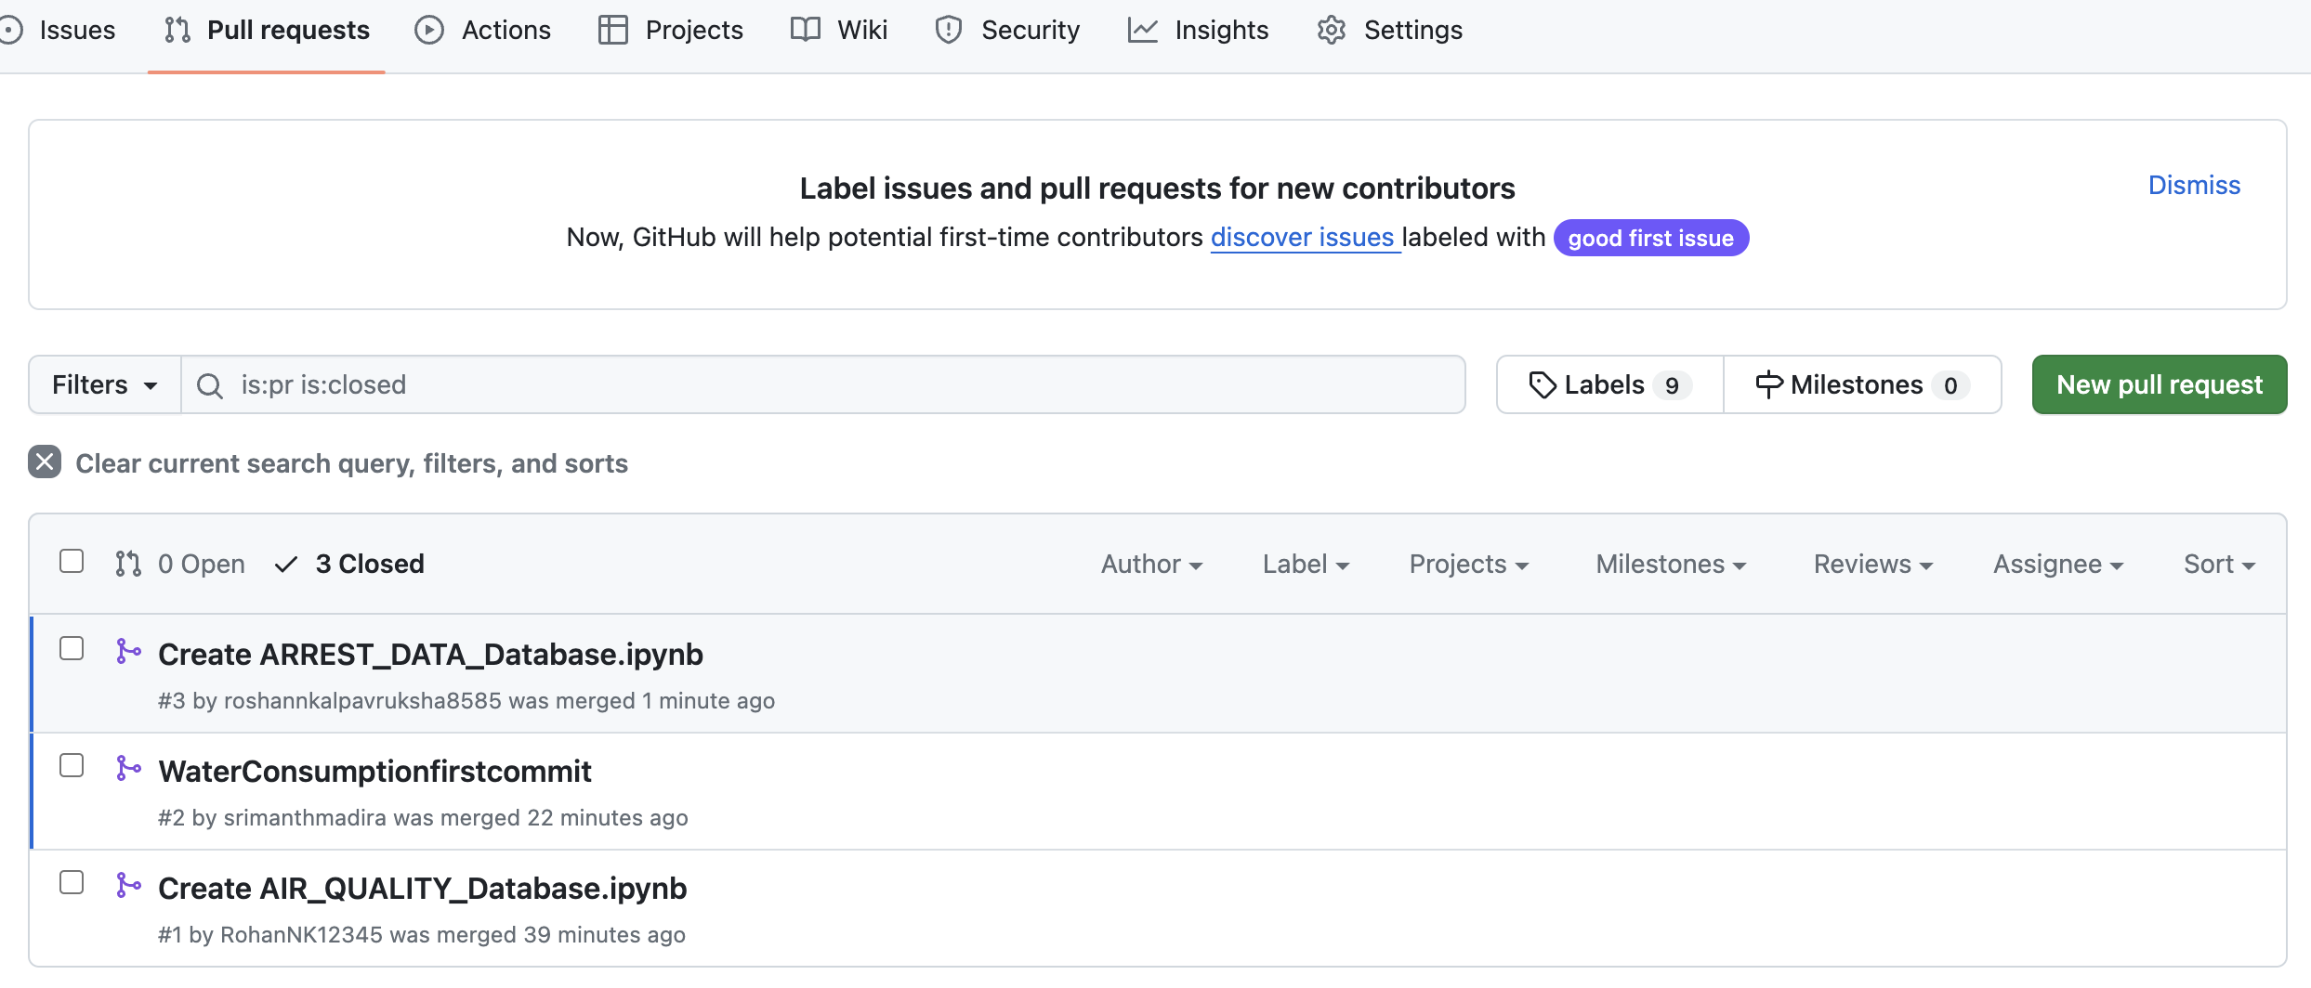
There has been collaborative work with the help of Version Control (Git)
SCALABLE DATABASE
MIDTERM PROJECT
4 Contributors
8+ Branches
BRAINSTORM BUDDIES
Multiple Commits
sql queries
data analysis
data source
objectives
data cleaning
git
Rohan Niranjan Kalpavruksha Roshan Niranjan Kalpavruksha Srimanth Madira Vaishnavi Koya
Multiple Pull, Push operations and a lot more

Slide 5
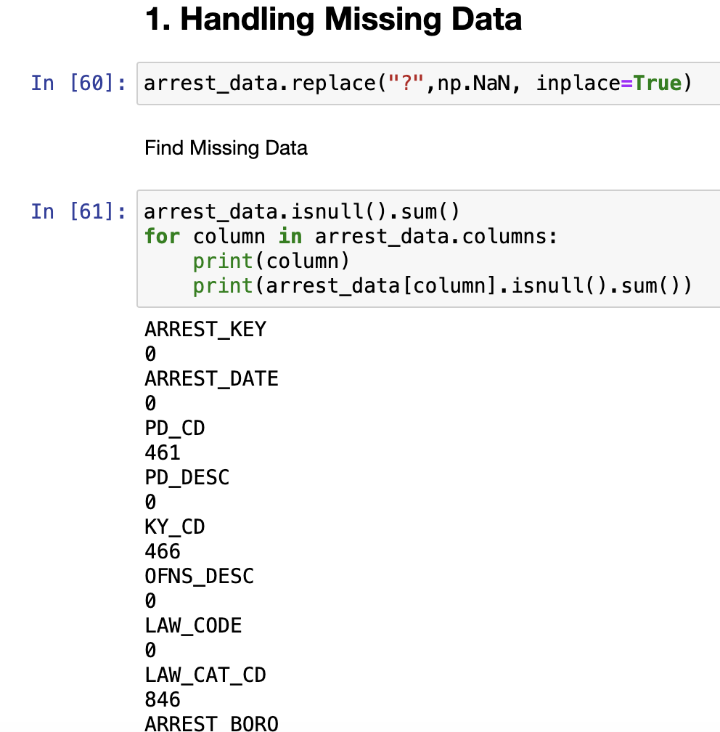


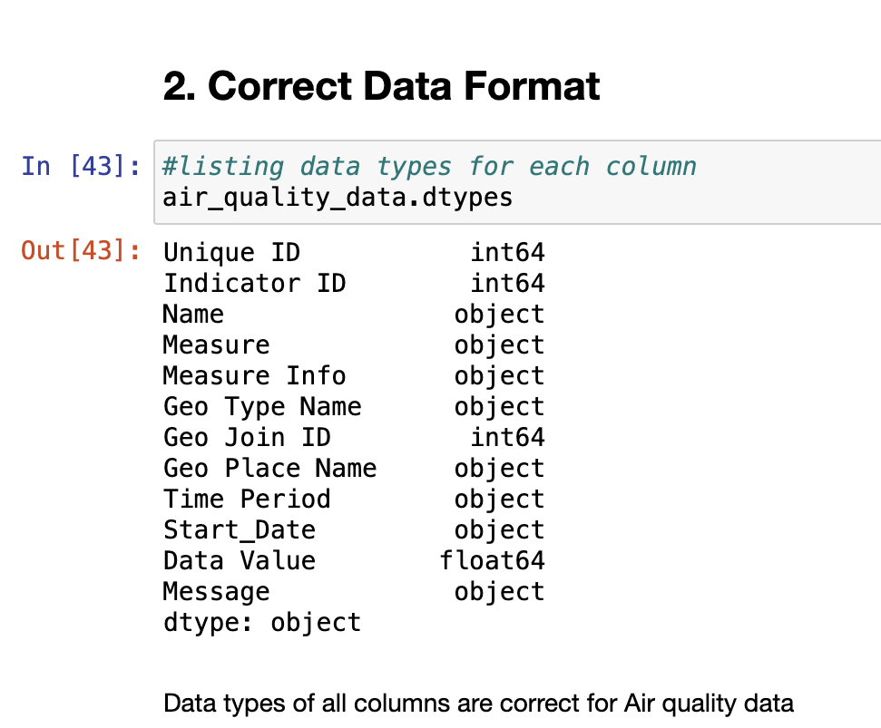
Handling Missing Data
SCALABLE DATABASE
MIDTERM PROJECT
Correcting
Data types
BRAINSTORM BUDDIES
sql queries
data analysis
data source
objectives
Handling
inconsistencies
git
data cleaning
Rohan Niranjan Kalpavruksha Roshan Niranjan Kalpavruksha Srimanth Madira Vaishnavi Koya
Standardizing and
Normalizing Data

Slide 6

ARREST
DATA
AIR QUALITY
DATA
WATER
CONSUMPTION
DATA
SCALABLE DATABASE
MIDTERM PROJECT
Top reasons for being arrested
Procedure to return area in which the offence has happened
Arranging the Borough Boundaries based on the crime rates
Reasons of arrest for a particular age group
Procedure to find the average data value of a particular gas
Filter and order the records based on data value
Grouping records based on Time Periods
Gases present in a particular geography
BRAINSTORM BUDDIES
Total Water Sewer Charges by Borough
Monthly total charges trend
Highest average consumption in 'Consumption Data‘
Funding source by HCF consumption
data analysis
sql queries
data source
objectives
git
data cleaning
Rohan Niranjan Kalpavruksha Roshan Niranjan Kalpavruksha Srimanth Madira Vaishnavi Koya

Slide 7


SCALABLE DATABASE
MIDTERM PROJECT
Pie Chart visualization for top records with Matplotlib
Correlation between features with Seaborn
BRAINSTORM BUDDIES
references
sql queries
future steps
insights
challenges
data analysis
Rohan Niranjan Kalpavruksha Roshan Niranjan Kalpavruksha Srimanth Madira Vaishnavi Koya
Plotting features after grouping with Pandas and Matplotlib

Slide 8
Majority of criminals are Males
Assault is the most prominent crime
Crime rate is Increasing Gradually
There are 62 distinct crime types
SCALABLE DATABASE
MIDTERM PROJECT
Manhattan has the highest consumption at 3,337,984 HCF
Majority of records (82%) are labeled as Not Estimated
BRAINSTORM BUDDIES
references
sql queries
future steps
insights
challenges
data analysis
Rohan Niranjan Kalpavruksha Roshan Niranjan Kalpavruksha Srimanth Madira Vaishnavi Koya
Most air quality data is recorded in
“2005-2007” & “2015-2017” time period
“Central Harlem - Morningside Heights”
has highest Data Value Percentage

Slide 9


SCALABLE DATABASE
MIDTERM PROJECT
Handling different data types together (for example numerical feature and categorical features which have string input)
Setting up all modules in a single platform that could handle both SQL Queries and Data Visualization part was challenging
Interpreting intricate patterns in visualizations with multiple variables.
BRAINSTORM BUDDIES
references
sql queries
future steps
insights
challenges
data analysis
Rohan Niranjan Kalpavruksha Roshan Niranjan Kalpavruksha Srimanth Madira Vaishnavi Koya

Slide 10
Predictive Modeling : Utilize predictive modeling for forecasting water consumption trends. Employ time series forecasting methods or machine learning algorithms to predict future consumption based on historical patterns. This step contributes insights for effective resource planning and management.
Automation of Data Processing : Develop automation scripts or workflows to streamline data cleaning, preprocessing, and visualization tasks. Create a pipeline that automatically updates and processes new data, ensuring efficiency and timely analysis. Automation enhances reproducibility and minimizes manual intervention in routine tasks.
SCALABLE DATABASE
MIDTERM PROJECT
BRAINSTORM BUDDIES
references
future steps
sql queries
insights
challenges
data analysis
Rohan Niranjan Kalpavruksha Roshan Niranjan Kalpavruksha Srimanth Madira Vaishnavi Koya

Slide 11
https://data.cityofnewyork.us/Housing-Development/Water-Consumption-And-Cost-2013-Feb-2023-/66be-66yr
https://data.cityofnewyork.us/Public-Safety/NYPD-Arrest-Data-Year-to-Date-/uip8-fykc
https://data.cityofnewyork.us/Environment/Air-Quality/c3uy-2p5r
https://medium.com/geekculture/48-data-visualizations-that-load-in-a-single-line-of-code-a0be5bea903b
https://www.datacamp.com/blog/data-visualization-techniques
https://stackoverflow.com/questions/28823371/data-wrangling-with-python-pandas/28823417
https://git-scm.com/book/en/v2/Getting-Started-About-Version-Control
SCALABLE DATABASE
MIDTERM PROJECT
BRAINSTORM BUDDIES
references
sql queries
future steps
insights
challenges
data analysis
Rohan Niranjan Kalpavruksha Roshan Niranjan Kalpavruksha Srimanth Madira Vaishnavi Koya

Slide 12


THANK YOU
RK68465N@pace.edu
RK25464N@pace.edu SM44262N@pace.edu VK55717N@pace.edu

